Slide 1
Writing at Pucklechurch

Slide 2
What does writing look like across the school?

Slide 3
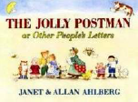
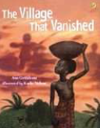
High Quality Texts
In English we use high quality books and creative teaching approaches.
This approach aims to engage and motivate children in their English learning.
It also enables children to deepen their understanding of texts and provides a meaningful context for writing.
We have introduced this approach into reception all the way through to Year 6.

Slide 4
Genres: Each term the children will complete a piece of fiction writing and a non-fiction piece of writing.
Fiction writing
Narratives (these will be based around their text
Creative writes
Character descriptions
Setting descriptions
poetry
Non-Fiction
Shopping lists
Labelling
Caption writing
Recounts of real events
Diary entries
Letters
Explanation texts
Non-chronological reports
Newspaper reports
Discussion texts

Slide 5
How do we support them to complete this piece of writing?
Each genre is planned on a 2 or 3 week cycle (depending on the outcome)
Skills are taught which will support them in writing their final piece
The children will explore vocabulary which is linked to their final outcome
The children will produce a ‘short burst’ write each week which will allow them to practise their skills which were taught

Slide 6
How do we support them to complete this piece of writing?
To support the children with building up their long write we immerse the children in their text with a range of activities
Role on the wall
Role play
Talk for writing
Links to our wider curriculum
Research sessions
Conscious ally

Slide 7
What will children have to support them in their writing?

Slide 8
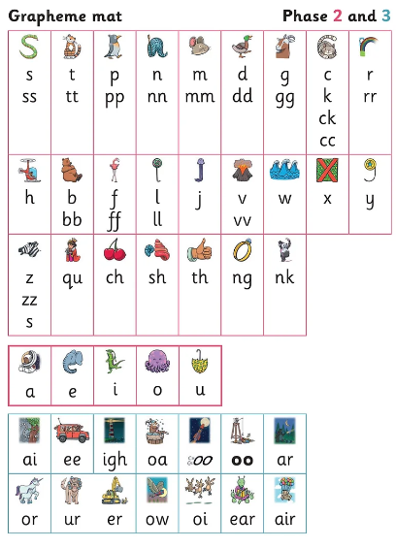
Phonics mats
Some year groups/ children use phonics mats which allow children to find the correct sound and the alternative spellings to that sound. We teach children to practise finding the correct sound and checking it looks right.

Slide 9
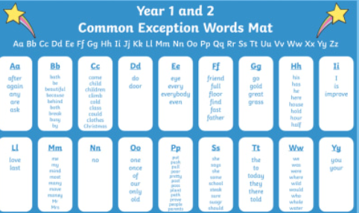
Common exception word mats
These allow children to find key spellings which they might get stuck on.

Slide 10
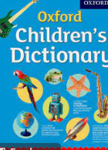
Dictionaries and Thesaurus
These are used more in KS2 to allow children to find alternative words or to check spellings

Slide 11
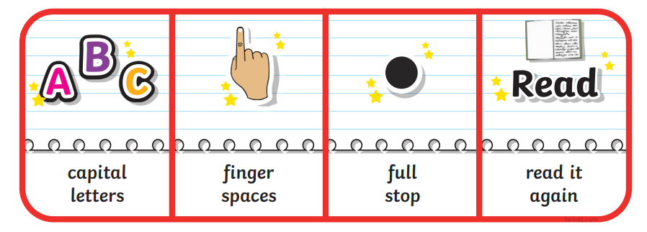
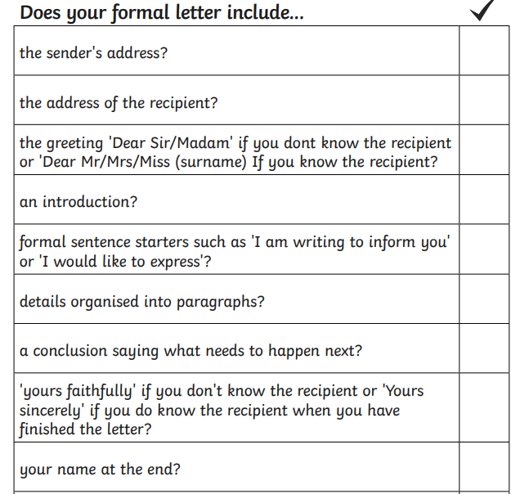
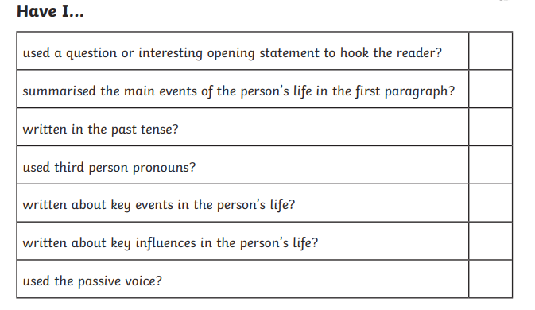
Skills ladders
The children will have skills ladders which allows them to add key skills where appropriate in their writing. Some children might have skills ladders which are tailored to the skills they are working on.
Biography Skills Ladder:

Slide 12
How we support children with their spellings?
In EYFS and Year 1 we use Little Wandle which teaches children spellings by applying their phonics sounds and the tricky part of common exception words
In Year 2 to Year 6 we teach spellings through Essential Spellings which still focus on phonics but also teaches children the spelling rule and how to apply them.
It focuses more on the teaching of spelling so that children understand how to apply patterns, strategies and knowledge to other words and not just a list of words given for that week. It also provides links to prior knowledge and tracks back to related objectives.
The Practise and Apply sections give children the opportunity to rehearse spelling patterns and use them in context. For example teachers will choose to use specific spelling words within their modelled writing to encourage children.

Slide 13
How to help your child:
Weekly spellings allow children to use and apply the spelling rules
Exposure of vocabulary through reading will allow children to magpie words that they can use in their own writing

